Slide 1
What’s in GDP? Lesson by Chris Cannon, AP macroeconomics teacher, Sandy Creek High School, Tyrone, Ga.

Slide 2
What is gross domestic product (GDP)?
Currency value of all final goods and services produced within a country in a given period
Total income of a nation
Measure of nation’s economic well-being
Measure of a nation’s economic growth from one period to the next
Most commonly calculated via expenditures
Notes:
First, a bit of history.
The Fed is the nation’s third central bank:
First Bank of United States did not have its charter renewed in 1811.
Similarly, the Second Bank of the United States did not have its charter renewed in 1836.
The United States has a legacy of distrust about concentrated financial power—the Fed recognizes and addresses that tradition in our commitment to accountability and transparency.
Between 1836-1913 there was no U.S. central bank:
Thus, there was no mechanism to prevent bank problems or to grow credit as economy expanded (the OCC was created in the 1860s, but most banks kept a state charter).
As a result, there were frequent bank panics and deep recessions—farm loans called in, forcing liquidation of farms, etc.
In 1907, there was a severe financial panic:
After that, there was debate between populists who favored strong political control over central bank and others who favored financial control (banker’s bank with expertise in credit).
Federal Reserve Act was passed in 1913:
It featured, a decentralized structure with FRBs and BOG, addressing concerns about concentration of power in D.C. and N.Y.
It also created a federal-level supervisor of state-chartered banks–the dominant type at the time–enabling prevention of many bank-related problems.
The Act also created a discount window for lending to banks on a short-term basis, which helped to provide a more elastic currency to grow the economy as business activity increased and to prevent bank runs from developing into panics and recessions.
The Fed was also given a payments role in the processing of cash and checks.
The Federal Reserve was created by Congress, and we are accountable to it– ultimately to the citizens of the United States. Over the years, the Federal Reserve has continued to evolve:
Banking Act (Glass-Steagall) 1933
Full Employment Act (Humprhey-Hawkins) 1978
Depository Institutions Deregulation and Monetary Control Act 1980
Financial Services Modernization Act (Gramm-Leach-Bliley) 1999
Wall St. Reform and Consumer Protection Act (Dodd-Frank) 2010

Slide 3
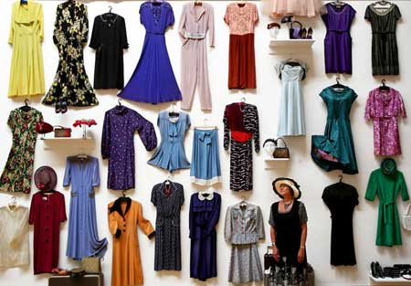
Consumption (C)
$ amount of goods and services purchased by household—only counts goods produced in the current year
Examples: Food purchases, vacations, haircuts, clothing, movies, etc
Notes:
Today, the Federal Reserve’s mission is to promote macroeconomic stability. The Fed does this in three ways, and I’ll discuss these at a very high level. Others will build on these in their discussions.
Monetary policy: The Fed is charged with helping our economy grow by keeping the overall price level stable and pursuing conditions favorable to healthy levels of employment.
Supervision and regulation: In this function, the Fed must examine financial institutions to help ensure they operate safely and soundly. The Fed works to keep the financial system stable and functioning, in both good and bad economic times.
Payments: In general, the Fed helps ensure that financial transactions made among businesses, consumers, and the government can be paid safely, efficiently, and reliably. Also, the Fed provides accessibility to payment systems for banks and financial institutions of all sizes, which improves accessibility and affordability of payments to consumers.
While other organizations in the United States are involved in economic policy, bank supervision, or financial payments processing, no other organization has responsibility for all three. Why is it important to have all three responsibilities? The simple answer is that any one of these functions has some bearing on the other.
Think about it. Without a strong economy, it’s difficult to have a strong financial system and vice versa. Also, it’s difficult to have a strong financial system if you aren’t confident that financial payments—cash, checks, and electronic payments—are going to function in a safe and efficient manner. That’s why the Fed’s role is so important to the nation’s economy and financial system.

Slide 4
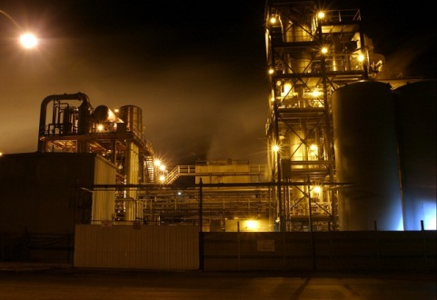
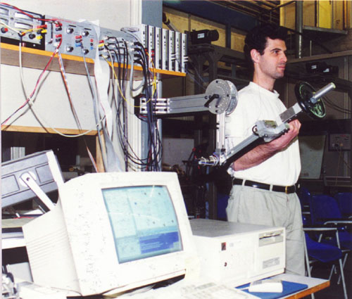
Investment (I)
$ amount spent by business on productive resources
Purchases of new homes by consumers!
New machines, new factories, research
Increase in inventories also counts
Notes:
The Federal Reserve is called upon to help U.S. consumers, workers, and businesses by pursuing conditions that foster economic growth and financial stability. We carry out our mission in a way that’s independent of day-to-day politics but accountable to Congress and the U.S. public.
Federal Reserve structure:
The Fed’s Board of Governors is a federal agency.
The Reserve Banks are set up independently. The head office of each Reserve Bank has a board of directors, whose primary role is to provide input on industry and economic developments.
The Financial Open Market Committee (FOMC) sets monetary policy for the United States. The committee includes the seven Fed governors, the president of the New York Fed, and rotating votes from four of the other 11 presidents each year (when the FOMC is fully staffed, 12 individuals vote). All Fed presidents participate in all discussions at each meeting.
Advisory councils: To help it gain perspective from outside the Fed, the System has a number of advisory councils, including a Consumer Advisory Council, Community Depository Institutions Advisory Council, and Federal Advisory Council. Reserve Banks also have advisory councils/committees.

Slide 5
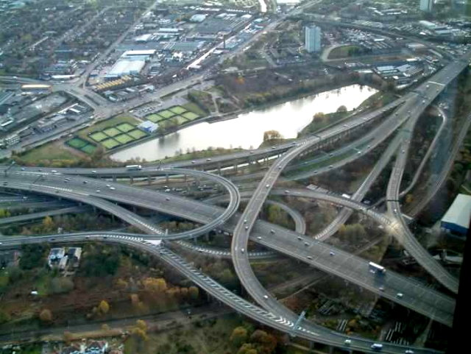
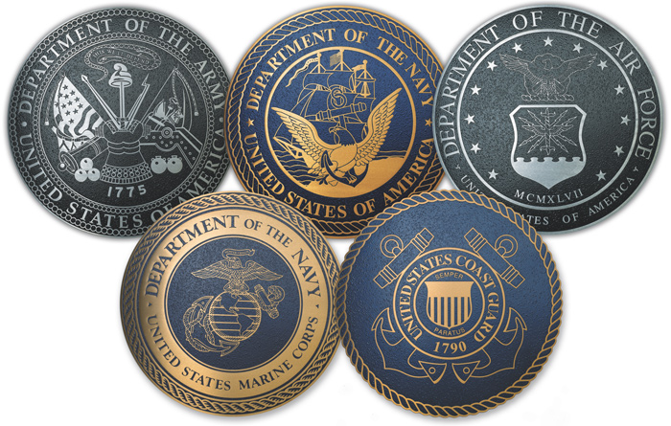
Government Spending (G)
$ amount spent on federal, state, and local government-provided services
Example: Roads, education, military, parks, public libraries, etc.
Notes:
Governor appointment:
As part of the U.S. government, the governors at the Board are appointed by the U.S. President and confirmed by the senate.
Political insulation:
To provide insulation from day-to-day politics, Congress decided the governors should have long terms (14 years) that last beyond a basic term for the president or a member of Congress or the Senate.
The Board does not receive its funding from the appropriations process. Instead, the Board receives its funding from the earnings of the Reserve Banks. (In 2011, the Fed returned about $77 billion of its net income of nearly $79 billion to the U.S. Treasury. Some of the difference reflected operating expenses for the 12 Reserve Banks and the Board of Governors, which totaled around $3.4 billion last year, as well as other accounting items.)
Lead role in key functions:
The Board of Governors has a central role in the Fed System.
Among other responsibilities, the Board has responsibility for bank regulation rule writing (they delegate supervision to Reserve Banks) and approval of bank mergers.
The Board also has the majority on the FOMC to set the fed funds rate and to approve discount rate changes
The Board also has Reserve Bank oversight responsibilities:
They approve the Reserve Bank presidents, FVPs, chair and deputy chair of Board of Directors.
They also approve each Reserve Bank’s budget and conduct audits of the Reserve Banks.

Slide 6
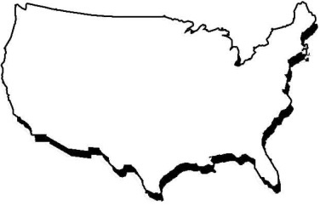
Net Exports (M-X)
Exports = Goods we ship to other countries
Imports = Goods we bring in from other countries
Exports – Imports = Net Exports
Notes:
Decentralized central bank:
As mentioned earlier, Congress set up the Federal Reserve to be a decentralized system.

Slide 7
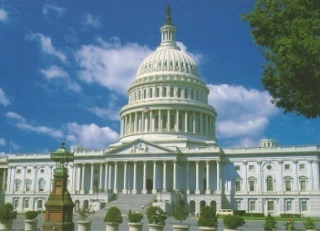
GDP = C + I + G + (M-X)
If any one letter increases, ceteris paribus, GDP increases
C + I + G + (M-X)
Notes:
Reserve Banks and branches:
There are 12 Federal Reserve Banks and 24 branches altogether. The Reserve Banks are the operating arms of the Fed, and participate in a number of critical functions—supervising banks, processing payments, and acting as the fiscal agent of the U.S. Treasury.
In a few moments, you’ll hear more about the Fed’s grassroots ties, but it is important to note that the Reserve Banks provide a strong tie to the on-the-ground economies of their regions. These ties are solidified through one-on-one meetings with businesses and consumer groups, group meetings of business people, surveys, anecdotal reports, etc.
However, some additional background on the Fed’s role in the nation’s payments system appears on the following slides..

Slide 8
The Payments Services Role
To ensure accessibility, reliability, and efficiency of payments
To ensure that currency is available, reliable, and genuine
To process checks and direct deposit/debit transactions
To conduct “wholesale payments” (New York Fed)
To serve as fiscal agent for U.S. Treasury
To anticipate new forms of payment (identify opportunities and risk)
Notes:
Payments goal
As a broad goal, the Federal Reserve is charged with ensuring that payments can be made reliably and efficiently in normal times and during crisis situations, such as following the 9/11 terrorist attacks or following Hurricane Katrina.
In addition, the Fed works with both large and small banks and financial institutions to ensure that payments are accessible to institutions of all sizes in a cost-efficient way.
Some of you may have heard the Fed called the “banker’s bank.” In many ways, that’s an appropriate description, as we provide payments services only to financial institutions. We do not provide payments directly to consumers. However, consumers and businesses through their banks do depend on the Fed payments systems to ensure that their cash, checks, direct deposit or bill payments, and government-related payments get paid into or out of their accounts.
Cash:
From a cash processing perspective, the Fed pays out new currency from the Treasury’s Bureau of Engraving and Printing and then processes currency that comes back into the Federal Reserve from commercial banks and financial institutions. The Fed must ensure that cash is readily available, is in good condition (not too worn or torn), and is genuine (not counterfeit). In 2011, Reserve Banks distributed 36.9 billion Federal Reserve notes into circulation (a 1.6 percent increase from 2010); the Fed received 35.1 billion notes from circulation (a .7 % decrease)—you can use these numbers but they will not be published by the Fed until the end of April.
Retail payments (checks and ACH):
The Fed also provides what are called retail payments to financial institutions.
You’ve probably heard that check usage has continued to shrink. In 2011, the Fed processed 6.8 billion checks versus 15.8 billion in 2003. The Fed was proactive in downsizing its operations to help facilitate this transition in a responsible way. In 2003, the Fed processed paper checks in 45 locations nationwide. Today, we process paper and electronic checks in one location.
Electronic transactions, such as automated clearinghouse (ACH) payments, like Direct Deposit or Direct Payment have grown dramatically. In 2003, the Fed processed 5.6 billion ACH transactions annually, while in 2011 we processed 10.4 billion transactions.
Wholesale payments:
The New York Fed provides a real-time gross settlement system where institutions are able to initiate large-value electronic funds transfers that are immediate, final and irrevocable. In 2011, the Fed processed 127 million wholesale transactions, totaling more than over $660 trillion.
Fiscal agent:
The Fed conducts auctions for bills, notes, bonds; collects taxes; processes social security and other consumer payments for the Treasury.
Future:
Many forms of payment are beginning to gain in popularity, including moblie payments, for instance. These new forms of payment provide many opportunities, but they also bring about new types of risk that must be understood and mitigated.

Slide 9
The Sixth Federal Reserve District
Atlanta head office, five branch offices
1,580 employees; 1,200 in Atlanta
Nine Atlanta board members; 35 branch board members
Special role over Fed’s retail payments activities
Region’s economy broadly similar to nation’s
Would represent world’s ninth largest economy
Notes:
The Atlanta Fed’s Sixth District has about 1,580 employees.
The Atlanta Fed has nine members on its board of directors and 35 members on the branch boards. Members represent a variety of types of large and small businesses. Currently, the Atlanta board chair is Carol Tomé, who is the chief financial officer of The Home Depot Inc., and the deputy chair is Tom Barkin, who is a director with McKinsey & Co. In recent years, one of the Atlanta Fed Board of Directors chair was a cotton farmer from Alabama, so both large and small businesspeople have chaired the boards.
The Atlanta Fed also has a role in managing the Fed System’s operations that support the nation’s retail payments system.
One note on the size and scope of the region’s economy: if the Sixth District region were an independent country, it would rank ninth among the world’s economies, between India and Italy.

Slide 10
Questions?

